Slide 1

Objectives
In this session, you will learn to:
  Identify the hardware of a portable computer
  Identify various classes of portable computer
  Identify the components of the system unit
  Identify the storage system of a PC
  Define display adapters and their types
  Define add-on cards
Notes:
Students have learnt the structure of different types of dimensions and the importance of surrogate keys in Module I. In this session, students will learn to load the data into the dimension tables after the data has been transformed in the transformation phase. In addition, students will also learn to update data into these dimension tables.
Students already know about different types of dimension tables. Therefore, you can start the session by recapitulating the concepts. Initiate the class by asking the following questions:
1. What are the different types of dimensions?
2. Define flat dimension.
3. What are conformed dimension?
4. Define large dimension.
5. Define small dimension.
6. What is the importance of surrogate key in a dimension table?
Students will learn the loading and update strategies theoretically in this session. The demonstration to load and update the data in the dimension table will be covered in next session.

Slide 2
Introducing Hardware
Computer hardware comprises of electronic components, such as CPU and monitor.
It also includes some electromechanical parts like keyboard, mouse, printer, scanner, disk drives, tape drives, loudspeakers for input, output, and storage.
Let us discuss some of the common I/O devices in detail.
Notes:
Share the session objectives with the students.

Slide 3
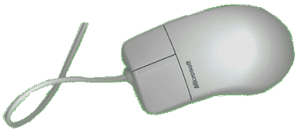
Common I/O Devices
Mouse:
  Is an input device that is important for graphical user interfaces because you can simply point to options and click a mouse button.
  These types of applications are often called point-and-click programs. Following figure displays a mouse.
Notes:
Explain the benefits to the students with the help of the examples provided in the student’s guide.
Provide the following example to the students to understand the need for storing information in a consistent format:
Consider an example of a manufacturing enterprise where the enterprise obtains the Bill of Material (BOM) from various suppliers. All suppliers refer to the same material using different names and specifications. When a data warehouse is designed, an appropriate name and specification for the same product needs to be designed in a consistent format.

Slide 4
Common I/O Devices (Contd.)
Mouse (Contd.):
  A mouse may have one, two, or three buttons. The function of each button is determined by the program that uses the mouse.
  Moving the mouse on a flat surface produces a corresponding movement of a pointer on the screen.
  Placing the pointer on an option and clicking the button results in selecting that option.
  A mouse may be classified as a mechanical mouse or an optical mouse, on the basis of the technology it uses.
  In a mechanical mouse, the ball that projects through the bottom surface rotates as the mouse is moved along a flat surface.
  An optical mouse uses a light beam instead of a rotating ball to detect movement across a specially patterned mouse pad.
Notes:
Explain the benefits to the students with the help of the examples provided in the student’s guide.
Provide the following example to the students to understand the need for storing information in a consistent format:
Consider an example of a manufacturing enterprise where the enterprise obtains the Bill of Material (BOM) from various suppliers. All suppliers refer to the same material using different names and specifications. When a data warehouse is designed, an appropriate name and specification for the same product needs to be designed in a consistent format.

Slide 5
Common I/O Devices (Contd.)
Mouse (Contd.):
  Following are some categories of mouse:
    Trackball mouse: In this, the ball is rolled at one place with the thumb, fingers, and palms rather than rolling the mouse on the table top.
    Joysticks mouse: It usually includes two upright sticks which are moved with the hand and a button is pressed on either stick.
    Light pen mouse: It utilizes a light-sensitive detector, requiring you to hold a pen and point it at the screen.
    Wireless mouse: It is a mouse without a cable. This mouse works up to one and a half metres away from the computer.
    Touch pad mouse: It is a touchpad is a small, flat, rectangular pointing device that is sensitive to pressure and motion.

Slide 6
Common I/O Devices (Contd.)
Scanner:
  A scanner scans an image and transforms the image to ASCII codes that is used by a computer to represent the characters you find on your keyboard, such as, alphabets, numbers, punctuation marks and graphics.
  There are three types of scanners:
    Flatbed scanner: It works like a copy machine except that it creates a file of the document rather than a paper copy.
    Sheetfed scanners: These devices are more like a fax machine, because they move the page being scanned past the scanning head, rather than the other way around.
    Handheld scanners: It is a scanning device where the scanning element is built into a small handheld unit.

Slide 7
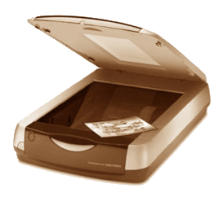


Common I/O Devices (Contd.)
  The following figure displays the various types of scanners.
Flatbed Scanner
Sheetfed Scanner
Handheld Scanner

Slide 8

Common I/O Devices (Contd.)
Touch Screen:
  Touch screens are normally used when information has to be accessed with minimum effort. Following figure displays a touch screen.
  There are four types of touch screens:
    Resistive touch screens
    Infrared touch screens
    Surface acoustic touch screens
    Capacitive touch screens

Slide 9
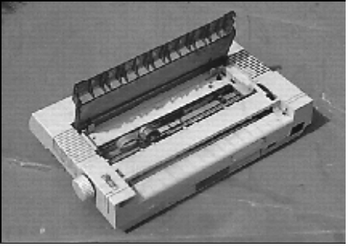
Common I/O Devices (Contd.)
Printer:
  Printers are output devices that print the result of an operation on paper.
  Printers are classified based on a number of parameters, like the mechanism used for printing, the speed of printing, the quality of output, the direction of printing, and the kind of interface they have with the computer.
  There are two main types of printers:
    Impact printers: In this, characters are printed by pressing a typeface against an inked ribbon, which makes a mark on the paper. The most commonly used impact printer is the Dot Matrix Printer (DMP).
Notes:
Tell the students that dimensions are components of data mart/ data warehouse. Dimensions will be discussed in details in Ch5.

Slide 10
Common I/O Devices (Contd.)
Printer (Contd.):
    Non-impact printers: In this, there is no contact between the typeface and the paper while printing.
    The main types of non-impact printer are:
      Laser printers
      Inkjet printer
      Thermal printer

Slide 11
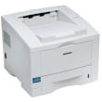
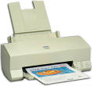

Common I/O Devices (Contd.)
    The following figure displays the various types of non-impact printer.
Laser Printer
Inkjet Printer
Thermal Printer

Slide 12
Common I/O Devices (Contd.)
Plotters:
  A plotter is an output device that is used to create presentation visuals, charts, graphs, tables, and diagrams.
  To draw clear and high-quality diagrams, a plotter needs
  high-quality pens with special inks of different colors.
  Plotters are of two types:
    Flatbed plotters: In this, the paper is held stationary while the arm and the pens move over it.
    Drum plotters: In this, the paper is wrapped around a drum and anchored at both ends. The drum rotates while the pen moves laterally along a fixed rail.
  A plotter can be connected to a PC through the parallel port.
  Plotters are used in applications like Computer Aided Design (CAD), which require high-quality graphics on paper.
Notes:
Tell the students that dimensions are components of data mart/ data warehouse. Dimensions will be discussed in details in Ch5.

Slide 13
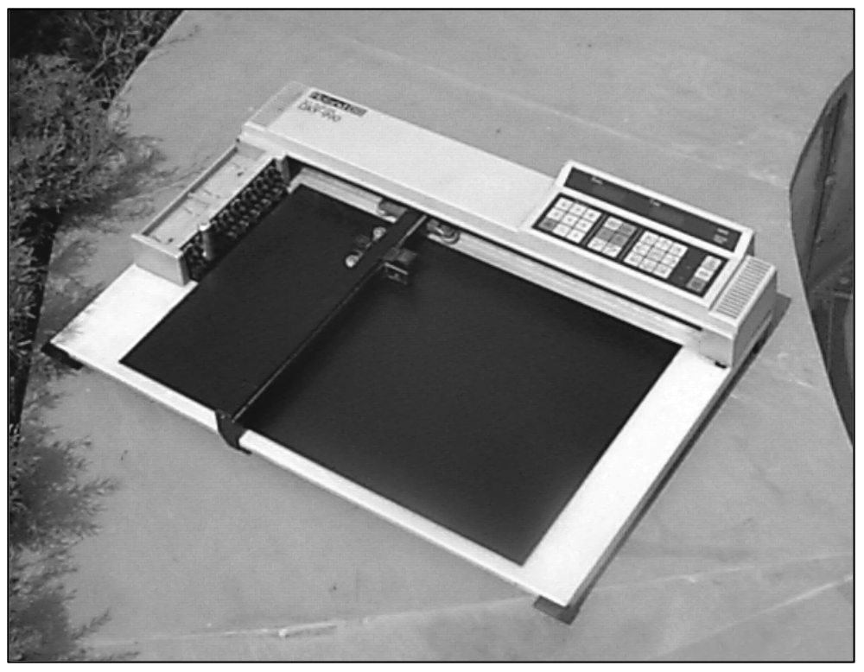
Common I/O Devices (Contd.)
Plotters (Contd.):
  The following figure displays a flatbed plotter.
Pen Holder
Pen
Arm
Flatbed
Notes:
Explain the benefits to the students with the help of the examples provided in the student’s guide.
Provide the following example to the students to understand the need for storing information in a consistent format:
Consider an example of a manufacturing enterprise where the enterprise obtains the Bill of Material (BOM) from various suppliers. All suppliers refer to the same material using different names and specifications. When a data warehouse is designed, an appropriate name and specification for the same product needs to be designed in a consistent format.

Slide 14
Storage Media
Data needs to be stored for later use on storage media.
The three types of storage media are:
  Cartridge tape
  Compact Disc-Read Only Memory (CD-ROM)
  Memory stick

Slide 15
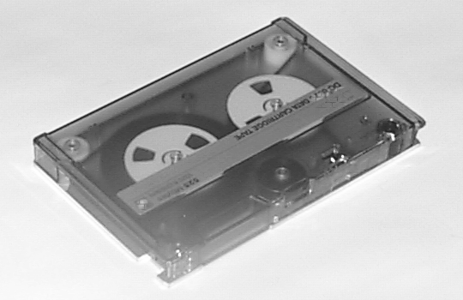
Storage Media (Contd.)
Cartridge Tape:
  Is made up of plastic films, coated with magnetic material
  Stores data sequentially
  Offers high storage capacities at relatively low costs
  Is ideal as a backup medium
  Is not recommended in cases where data is required at random and at high speeds
  Requires a cartridge tape drive to read and write on the tape

Slide 16
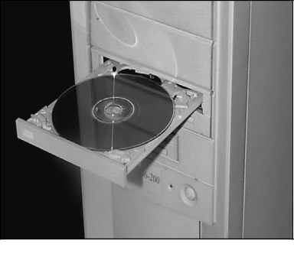
Storage Media (Contd.)
CD-ROM:
  Can store large quantities of data (700 MB or more)
  Cannot be erased and written onto unlike diskette
  Requires a CD-Recorder to write on to discs
  Requires a CD-ROM drive to read data from it
CD-ROM
CD-ROM
Drive

Slide 17

Storage Media (Contd.)
Memory Stick:
  Is designed to become a standard digital data storage and
  transfer media
  Is portable, light, reliable, and easy-to-use
  Created by Sony company, can save upto 128 MB data

Slide 18
Introducing Classes of Portable Computers
Personal Computer (PC) can be classified in to two broad groups:
  Desktops: Can not be carried around and used while traveling
  Portables: Can be carried around and used while traveling

Slide 19
Characteristics of Portable Computers
Portable computers are productivity-enhancement tools that allow busy executives to carry their office work with them.
The critical criterion for a portable computer is size. The smaller the size, the easier it is to carry around.
Some of the innovative techniques being used to reduce the size of a portable computer are:
  Liquid Crystal Displays (LCDs) are used, as they are light and consume very little power.
  The number of keys on the keyboard is reduced, and the keys are made to perform multiple functions.
  The size of hard disk is reduced.
To conserve power, techniques like switching off the hard disk drive when not in use and using power-conserving microprocessors are utilized.

Slide 20
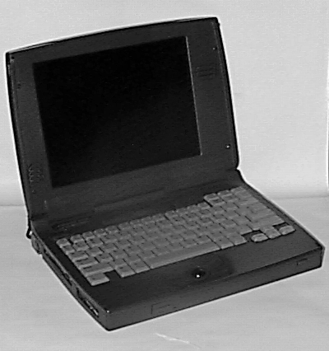
Characteristics of Portable Computers (Contd.)
The following figure displays a portable computer.

Slide 21
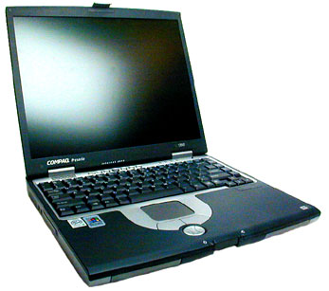
Classes of Portable Computers
Classes of Portables:
  Laptops:
    Are small, slim, and attach case computers weighing between
    1.7 kg and 4 kg
    Offer the same power as a desktop computer
    Are essentially scaled down desktops and use a reduced keyboard and mouse as input devices
    Bulky when compared to notebooks
    Examples of laptops are IBM ThinkPad, Acer, and Lenovo
  The following figure displays a laptop.

Slide 22
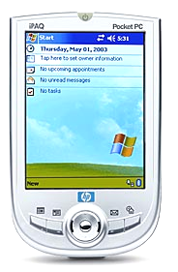
Classes of Portable Computers (Contd.)
Classes of Portables (Contd.):
  Palmtops:
    Are the smallest of portables and are normally of the size of a pocket calculator
    Do not offer the same power as that of a PC
    Are useful for data entry operations in the field
    Some examples of palmtops are BlackBerry 8700c,
    Hewlett-Packard's 200LX, and Toshiba's e755
  The following figure displays a palmtop.

Slide 23

Classes of Portable Computers (Contd.)
Classes of Portables (Contd.):
  PDA:
    Is a handheld computing device that allows I/O operations on data
    Contains at least one database with names and address book,
    to-do lists, memo pad, notepad, and a library of medical information
    Has features that include networking, wireless communication features, voice recording, and telephone/fax integration
    Some examples include Apple Newton, Casio Cassiopeia, and so on
  The following figure displays a PDA.

Slide 24
Bluetooth Technology
Is a wireless protocol that is used to communicate from one device to another in a small area usually less than 30 feet.
Is a wireless, low-cost radio solution that enables small devices such as PDAs, cell phones, and palmtops to communicate between each other and with the Internet.
Enables data connections between electronic devices such as desktop computers, wireless phones, electronic organizers and printers in the 2.4 GHz range.
Depends on mobile devices equipped with a chip for sending and receiving information.
Is used in Wireless headsets, Mobile phones, Handheld PCs, Consumer electronics (cameras, VCRs, Walkman), and Entertainment robots.

Slide 25
Introducing Components of the System Unit
The system unit is a box-like unit filled with a number of useful components, each performing a discrete function.
The components work together to accomplish the main function of the computer, viz. accept and process input and deliver output.

Slide 26
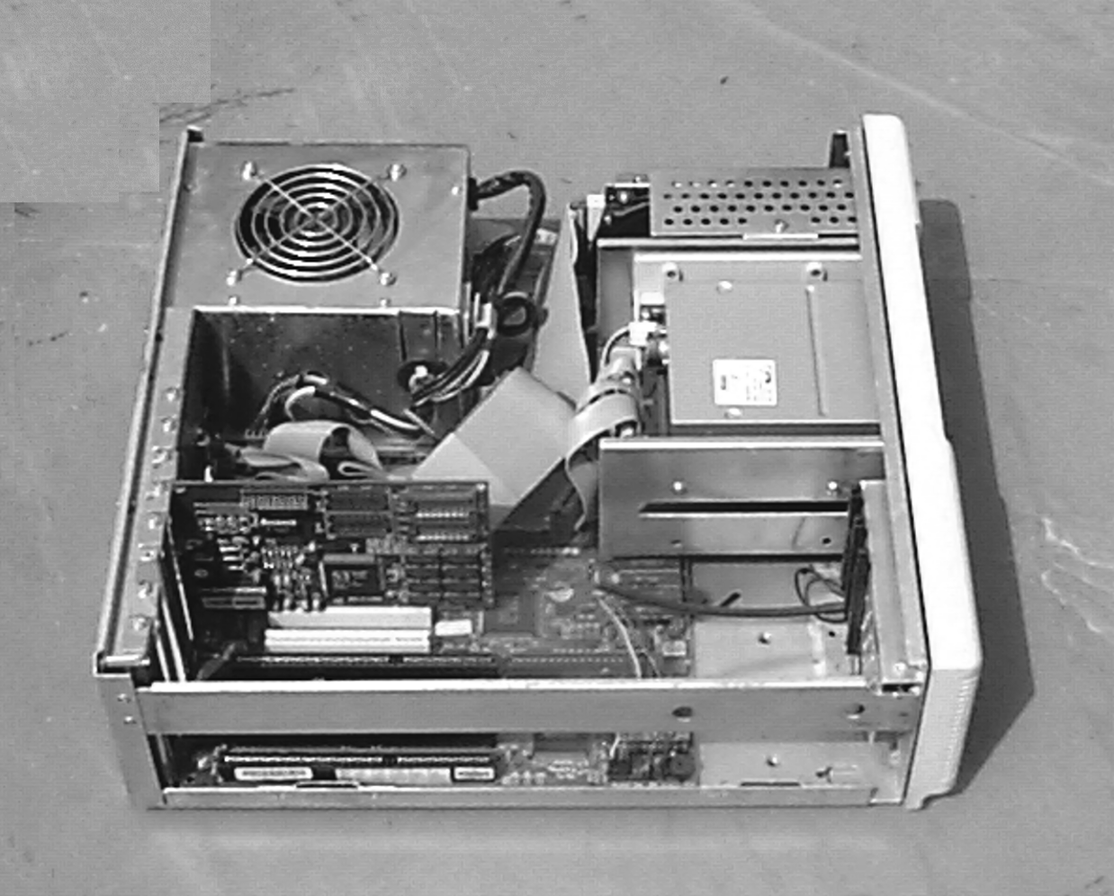
Introducing Components of the System Unit (Contd.)
The following figure shows the various components of the system unit.
Let us discuss each component of the system unit in detail.
Fan and SMPS
Hard Disk Drive
Controller Cables
Floppy Disk Drive
Hard Disk and Floppy Disk Controller
Speaker
Motherboard

Slide 27
Introducing Components of the System Unit (Contd.)
Internal Power Supply:
  Internal power supply is referred to as Switched Mode Power Supply (SMPS).
  SMPS provides cable connectors to supply the required voltage to the other internal components like the floppy drives, the hard disk drive, the motherboard and external device such as the keyboard.
  The ON/OFF switch of the system unit is actually a part of the SMPS.

Slide 28
Introducing Components of the System Unit (Contd.)
Exhaust Fan:
  The SMPS has a small fan, called the exhaust fan, which rotates as long as the computer is switched on.
  The function of the exhaust fan is to cool the SMPS unit.
Speaker:
  The speaker is connected to the motherboard and produces a sound whenever instructed by software programs.

Slide 29
Introducing Components of the System Unit (Contd.)
Motherboard:
  Motherboard is a large board, which contains number of tiny electronic circuits and other components that are visible.
  All peripheral devices are connected to the motherboard.
  The components of the motherboard are:
    Chipset
    Microprocessor
    Clock chip
    Memory - RAM and ROM
    Bus
    Ports

Slide 30
Introducing Components of the System Unit (Contd.)
Expansion Slots:
  The motherboard has a set of sockets, called expansion slots that help you attach extra input and output devices, in case you run out of ports.
  They are of three kinds of expansion slots:
    Industry Standard Architecture (ISA)
    Peripheral Component Interconnect (PCI)
    Accelerated Graphics Port (AGP)

Slide 31
Storage Systems
The storage system consists of three logical parts:
  The medium itself, such as the diskette, the cartridge tape, or the hard disk.
  The mechanism that operates this medium – spins the disk or spools the tape. This is called the drive.
  The electronics that controls the drive through commands given by the computer system. This is called the controller.
The different types of storage system are:
  Floppy disk system
  Hard disk system
  Compact disc system
  Magneto-optical disk system

Slide 32
Floppy Disk System
Floppy disks are circular in shape with a hole in the center, called the clamping hole.
The clamping hole is covered with a square protective jacket.
The jacket has an oval slot, called the head slot, which exposes a portion of the diskette surface.
The index hole is the starting point of the diskette.
The drive contains a spindle mechanism for rotating the diskette.
The drive also contains the read-write head that accesses the disk surface through the head slot and retrieves or stores data.

Slide 33
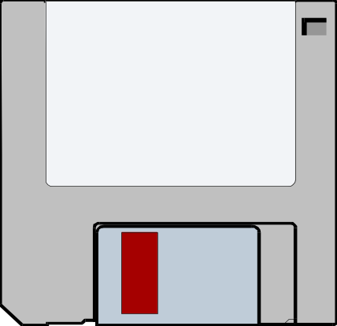
Floppy Disk System (Contd.)
The following figure shows the floppy disk.
The storage capacity of a disk is determined by factors like the number of tracks, sectors and the number of sides on which data is recorded.
Floppy disk drives can be double-density or high-density drives.
Write Protect Tab
Hard Cover Jacket
Paper Label
Media Cover

Slide 34
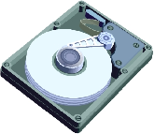
Hard Disk System
The hard disk is made up of a collection of disks known as platters.
The read-write mechanism in a hard disk is positioned over the recording surface and the disk is rotated.
The hard disk controller performs functions similar to that of a floppy disk controller.
The following figure displays the hard disk system.

Slide 35
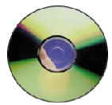
Compact Disc System
Compact Disc-Read Only Memory (CD-ROM) is a very popular storage medium.
The CDs used in a CD-ROM can store vast quantities of data – 700 MB or more.
A CD-ROM cannot be erased or written onto without the help of a special device called the CD-Recorder.
The following figure displays the compact disc system.

Slide 36
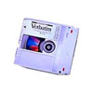
Magneto-Optical Disk System
A Magneto-Optical (MO) disk is a reliable media for
long-term data storage extending to over 30 years.
MO disks can resist dust, magnetic fields, Ultra Violet rays and X-rays.
MO drives are used for transferring large volumes of data, as well as storing and archiving files in industries, such as publishing, telecommunications, medical, and banking.
The following figure displays a MO disk.

Slide 37
Introducing Display Adaptors and Their Types
Images are formed on the monitor’s screen by a card called the display adapter card.
The key elements of a display adaptor are the video controller and the memory.
Some of the parameters that are used to distinguish between the various display adaptors are:
  Display in text mode
  Resolution in graphics mode
Some of the popular display adaptors are:
  EGA
  VGA
  SVGA

Slide 38
Introducing Display Adaptors and Their Types (Contd.)
EGA:
  It unifies the features of a variety of display adaptors.
  It supports up to 16 colors at a time.
  It is expensive and is not supported by specific software provided by some vendors.
  It has a resolution of either 640 x 200 pixels or 640 x 350 pixels.

Slide 39
Introducing Display Adaptors and Their Types (Contd.)
VGA:
  It provides a resolution of 720 x 400 pixels in text mode.
  In graphics mode, the resolution is either 640 by 480 with 16 colors or 320 by 200 with 256 colors.
  The total palette of colors supported by VGA card is 262,144.
  It uses analog signals instead of digital signals.
  It supports both All Points Addressable graphics modes, and Alphanumeric Text modes.
  Like EGA, it is quite expensive.

Slide 40
Introducing Display Adaptors and Their Types (Contd.)
SVGA:
  It is an improvement on the VGA.
  It was developed by a industry-standards consortium called the Video Electronic Standard Association (VESA) in 1989.
  It provides many combinations of resolution and color.

Slide 41
Introducing Add-On Cards
An add-on card is a special piece of hardware, which is required for communication between the PC and other electronic devices.
Some of the most common add-on cards are:
  Video Card
  Network Interface Card (NIC)
  Modem Card
  Sound Card
Notes:
Note:
The data warehouse lifecycle is compared with the Software Development Life Cycle (SDLC). In a SDLC, the phases are: requirements gathering, analysis, design, programming, testing, integration, and implementation. The data warehouse lifecycle also starts with collection of requirements and analysis, and ends with the testing, deploying, and maintaining the data warehouse.

Slide 42
Summary
In this lesson, you learned:
  Some input and output devices that you will find in a working environment are:
    Printers
    Scanners
    Plotters
    Touch screens
  Some data storage media used for storing large volumes of data are:
    Cartridge tape
    CD-ROMs
    Memory stick
  The PC range includes desktops, laptops, notebooks, and palmtops.

Slide 43
Summary (Contd.)
  Bluetooth is a wireless protocol that is used to communicate from one device to another in a small area.
  Components of the system unit are the power supply with exhaust fan, the speaker, the motherboard, the disk drives, and the adaptor cards.
  The motherboard contains various components like:
    Chipset
    Microprocessor—Popular microprocessors are Intel 8088, 80286, 80386, 80486, Pentium
    Bus
    Ports
  Storage System inside a PC consist of three logical parts, which are as follows:
    Diskette
    Drive
    Electronics that control drive through commands

Slide 44
Summary (Contd.)
  The display adaptor controls what appears on the VDU. Commonly-used display adaptors are EGA, VGA, and SVGA.
  An expansion slot allows attaching of additional devices to the computer. Add-on cards are plugged into the expansion slots. They increase the capabilities of your computer.

